Slide 1
Streamline Data Flow
By V Venkata Sri Prasad

Slide 2
Agenda
Project Statement
Project Overview
Process Flow
Azure Resource Used
Project Requirements
Implementation
Reference

Slide 3
Project Statement
Create a solution for real-time data processing where Azure Data Factory is used to ingest streaming data, and Azure Databricks processes and analyzes the data in near-real-time using Spark streaming.

Slide 4
2. Project Overview
This project aims to build a real-time data processing solution leveraging Azure Data Factory for ingesting streaming data and Azure Databricks for processing and analysing the data in near-real-time using Spark streaming.
Key Components:
Azure Data Factory (ADF):
Azure Databricks:
Data Factory ensures that data flows seamlessly from source to destination in real-time, allowing businesses to stay up-to-date with the latest information.
Databricks enables organizations to analyze and derive insights from streaming data as it arrives, empowering them to make informed decisions and take immediate actions based on the most current data available.

Slide 5
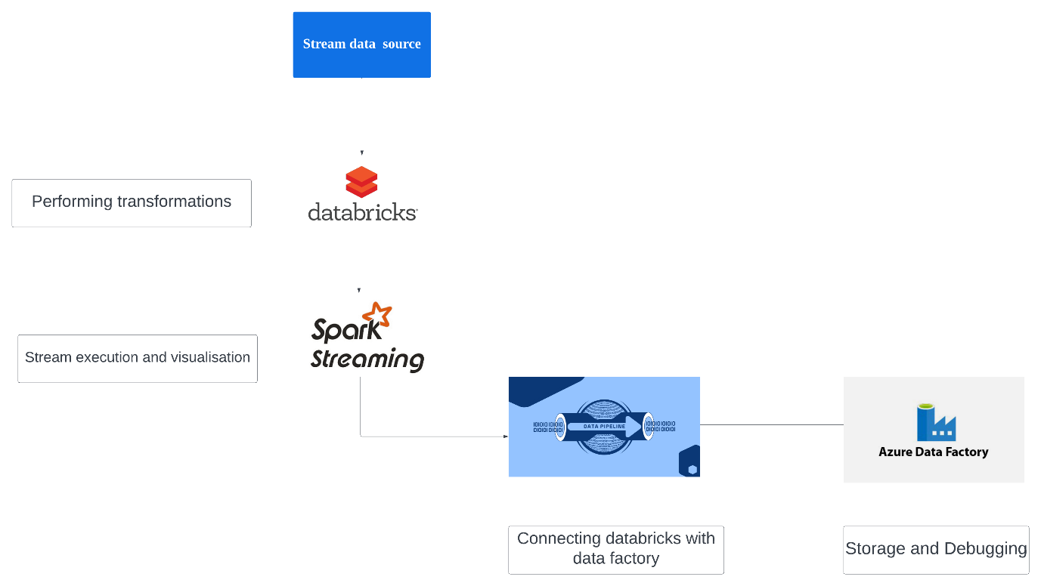
3. Architecture Diagram:
Step 1. Data travels from source to databricks notebook
Step 2. Databricks performs the necessary transformations.
Step 3. Using sparking streaming , streaming will be initialised
Step 4. Using a pipeline , Notebook data will be ingested into datafactory

Slide 6
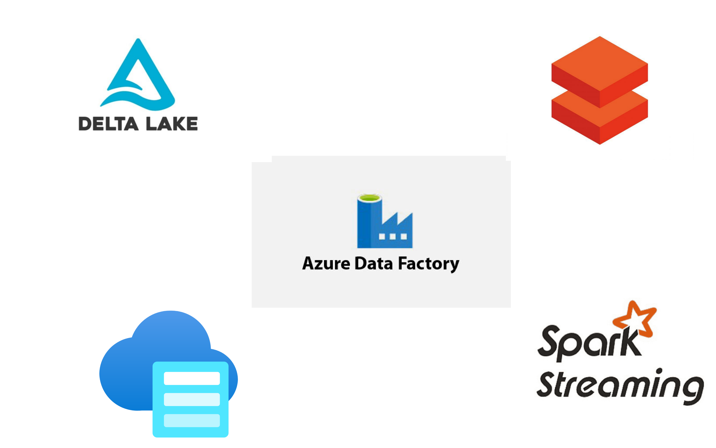
4. Azure Resources Used
Azure Data Factory: Cloud-based data integration service for creating, scheduling, and managing data pipelines.
Azure Blob Storage: Scalable object storage service for storing and managing unstructured data in the cloud.
Azure Databricks: Apache Spark-based analytics platform optimized for Microsoft Azure.
Delta Lake or Delta Table: Open-source storage layer providing ACID transactions, data versioning, and schema enforcement to Apache Spark workloads.
Spark Streaming: Extension of Spark API enabling scalable, fault-tolerant stream processing of live data streams.

Slide 7
5. Project Requirements
Streaming Data Source: Utilize Azure Data Factory to ingest streaming data from Delta table
Data Transformation and Preprocessing: Implement data preprocessing tasks within Azure Data Factory to cleanse, transform, and enrich the incoming streaming data.
Integration with Azure Databricks: Establish integration between Azure Data Factory and Azure Databricks to seamlessly transfer the pre-processed streaming data for further analysis.
Near-Real-Time Analysis: Leverage Azure Databricks to perform near-real-time analysis on the streaming data.
Scalability and Performance: Design the solution to be highly scalable to handle varying data volumes and processing demands.

Slide 8
6. Implementation

Slide 9
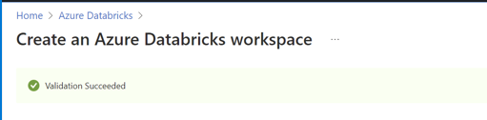
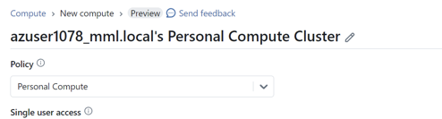
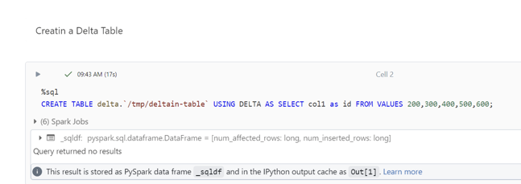
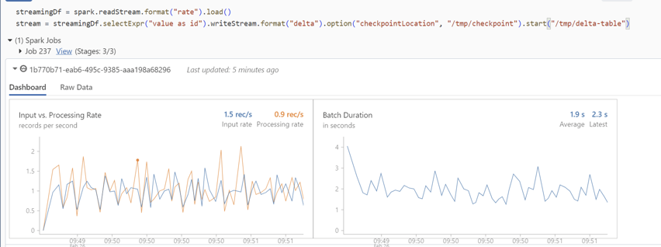
6.1 Azure Databricks
Create a Azure Databricks account and Open the workspace
Create a Cluster and notebook
For data source we will be creating a Delta table and insert views in the table
Perform transformation, cleaning and using spark streaming initialize the visualization

Slide 10
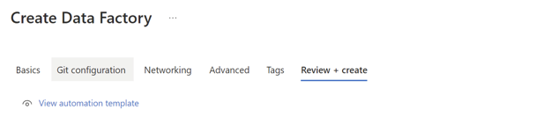
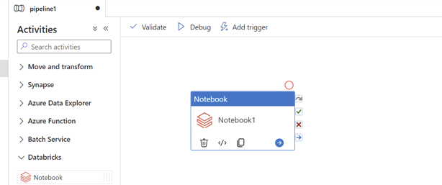
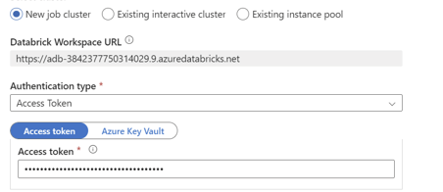
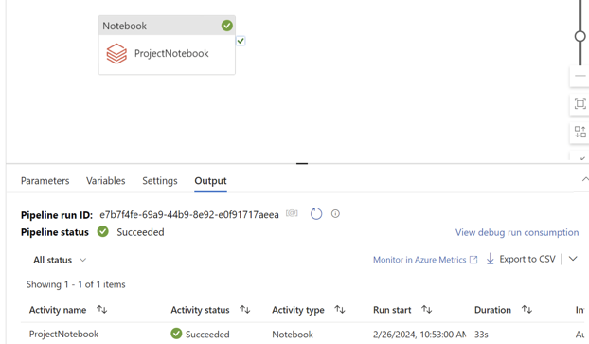
6.2 Azure Data Factory
Create a Azure Data Factory account and Open the workspace
Create Pipeline with notebook in it.
Provide the access key for the pipeline connection.
Validate and debug the pipeline which we have created

Slide 11
Reference
https://learn.microsoft.com/en-us/azure/data-factory/transform-data-using-databricks-notebook

Slide 12
Thank you

